Slide 1
Which family movie categories are rented the most?
Family Movie Rental Analysis
Animation
1166
Family
1096
Children
945
Comedy
number of rented days
941
Classics
939
Music
830
The analysis shows that Animation and Family movies are the most frequently rented categories, indicating strong engagement with content that appeals broadly across age groups.
Notes:
Query 1

Slide 2
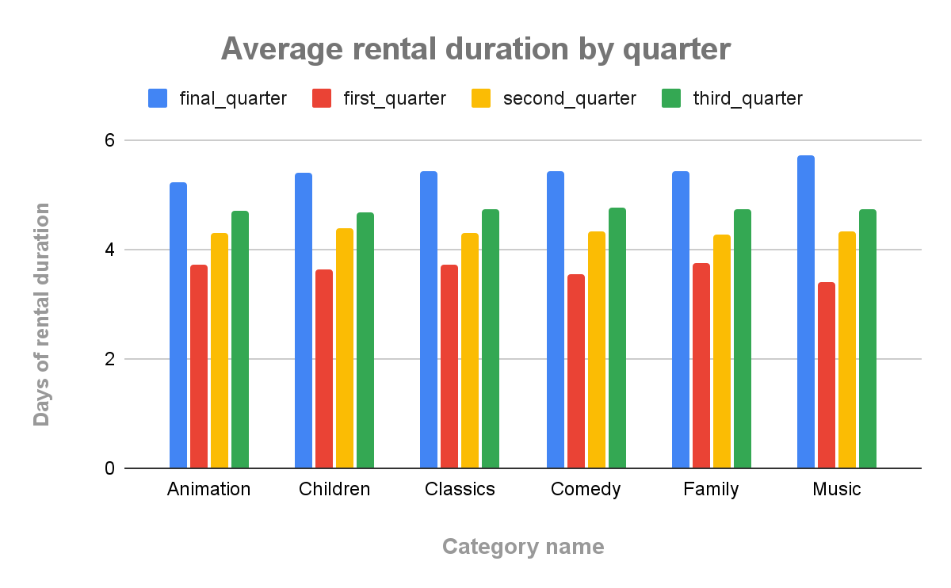
How are family-friendly movies distributed across rental quartiles?
Most family-friendly movies fall into the shortest rental-duration group (Q1), while fewer appear in the longest group (Q4). The most common categories across all quartiles are Family, Animation, and Children, suggesting these genres drive most of the rental activity.
<visualization>
Notes:
Query 2

Slide 3
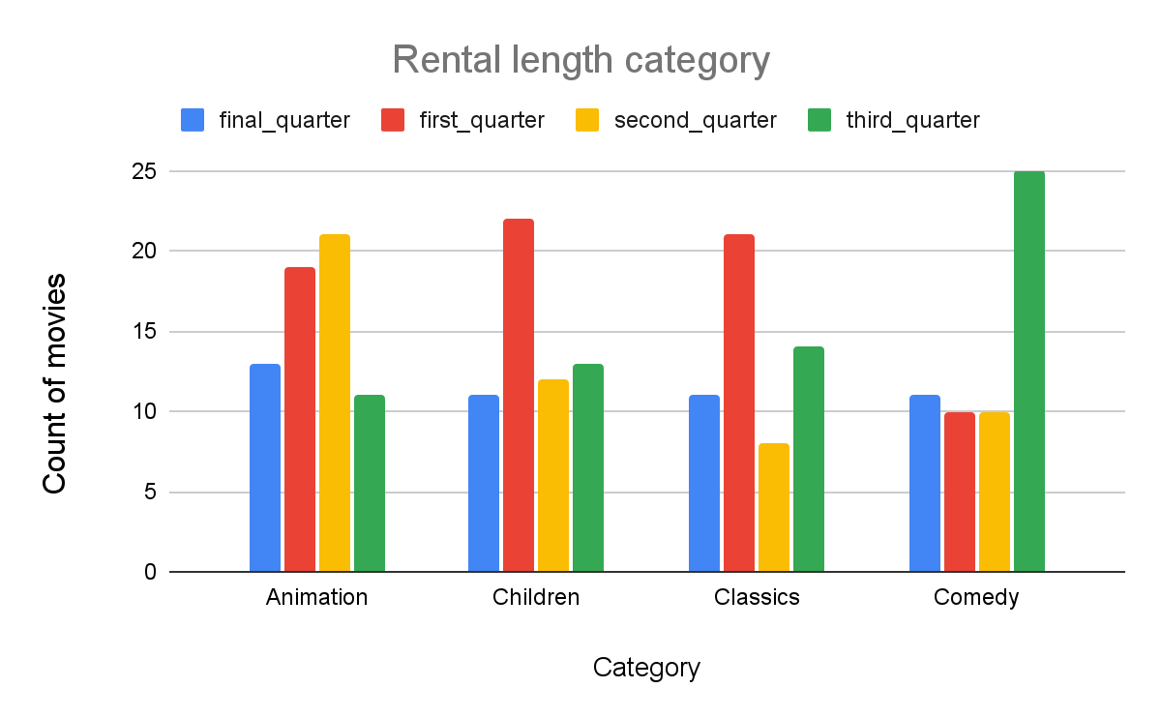
How do family-friendly movie categories compare across rental duration quartiles?
<visualization>
Most family-friendly movies fall in the shortest rental-duration quartile, but categories like Family and Animation appear heavily across all quartiles, showing stable popularity.
Notes:
Query 3

Slide 4
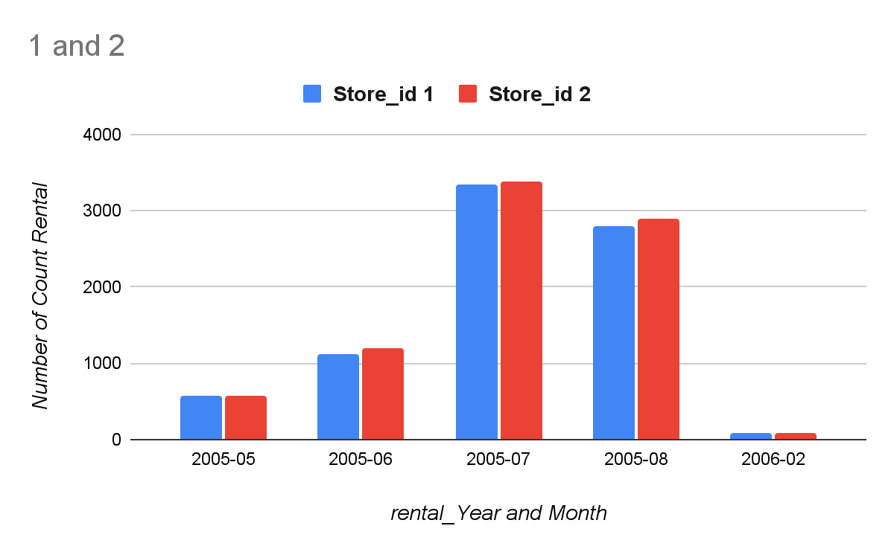
How do the two stores compare in the number of rental orders they fulfill each month?
The chart shows that both stores follow similar monthly rental patterns, but Store 2 consistently fulfills slightly more rental orders than Store 1 in most months. This indicates comparable performance overall, with Store 2 maintaining a small but steady lead in total rentals.
<visualization>
Notes:
Query 4

